Slide 1


Work Related learning
Week 8-
Theories Of Organisational Culture

Slide 2

Presenting your assignment
Title page-Your student number, the module and submission date
Content page
Introduction
Font –Ariel, Times New Roman
Font size -12
Line spacing – 1.5
Paragraphing-Not too short or too long
Page number
In text referencing
Reference list using Harvard referencing style
Reference list should be in alphabetical order
Proof read for grammar errors
Submit as a single document i.e. a word document or Pdf
Conclusion

Slide 3
Learning outcomes
Be
At the end of this session, students will be able to ;
Describe
1-Define Organisational Culture
Explain
2-Identify Theories and Models Of Organisational Culture .

Slide 4
LO1- Individual Research – (5 mins)
Conduct an internet search ;
What is organisational Culture ?

Slide 5
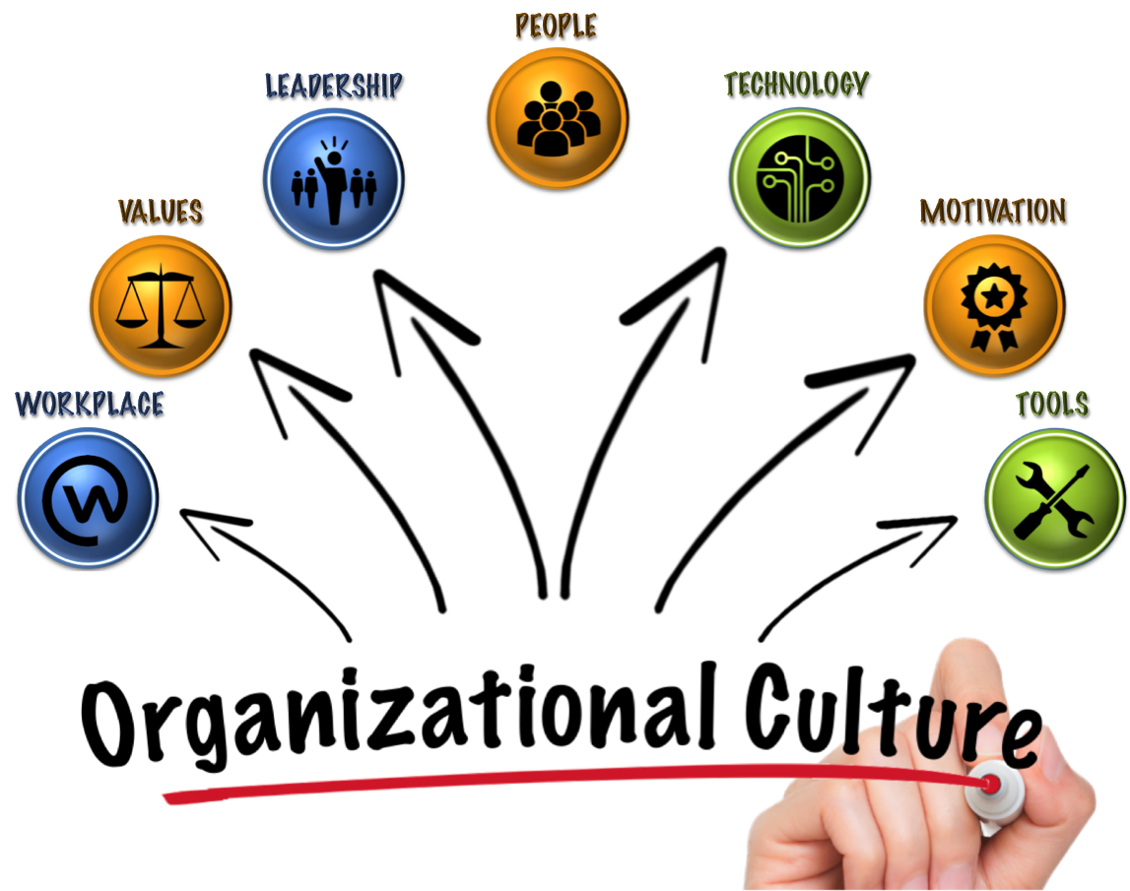
An organization's culture defines the proper way to behave within the organization.
This culture consists of shared beliefs and values established by leaders and then communicated and reinforced through various methods, ultimately shaping employee perceptions, behaviors and understanding.
Organisational culture is ‘how we do things round here’.
It represents the collective values and beliefs of the people who work in the organisation and is influenced by its history, its primary task, key individuals, management strategy, external constraints and circumstances.

Slide 6

Similarly to some other components of Organisation Design, the concept of Organisational Culture (often used with its synonym of Corporate Culture) developed around the 1960s and has since steadily be used in management.
Organizational Culture is a system of shared assumptions, values and beliefs that governs how people behave in organizations.
The culture of an organization is determined by the values placed on a set of characteristics, such as risk orientation and attention to detail.

Slide 7
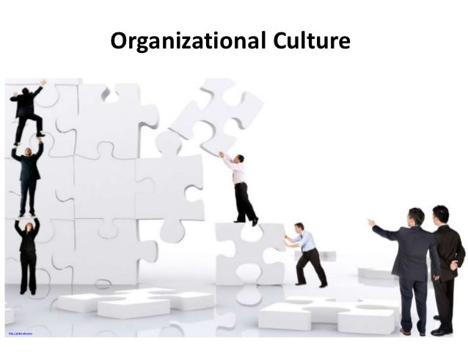
Organizational Culture is a group of internal values and behaviors in an organization.
It includes experiences, ways of thinking, beliefs and future expectations.
It is also intuitive, with repetitive habits and emotional responses.
Organizational Culture is the result of a perception within the company that its employees all share.
We also call it Corporate Culture.

Slide 8

Organizational culture can manifest itself in a variety of ways, including leadership behaviors, communication styles, internally distributed messages and corporate celebrations.
Given that culture comprises so many elements, it is not surprising that terms for describing specific cultures vary widely.
Some commonly used terms for describing cultures include aggressive, customer-focused, innovative, fun, ethical, research-driven, technology-driven, process-oriented, hierarchical, family-friendly and risk-taking.

Slide 9
https://youtu.be/2aiJY4xfeZc
Every organisation will posses its own unique culture.
However, without nurturing a healthy and positive organisational culture, a negative culture can corrupt an organisation from the inside out.

Slide 10
Importance
Organizational culture is the DNA of your company; it provides the backbone for your company's guidelines, boundaries, goals, mission, and vision.
Your company culture impacts your employees' performance and influences how others perceive your company.
Conversely, an ineffective culture can bring down the organization and its leadership.
Disengaged employees, high turnover, poor customer relations and lower profits are examples of how the wrong culture can negatively impact the bottom line.

Slide 11
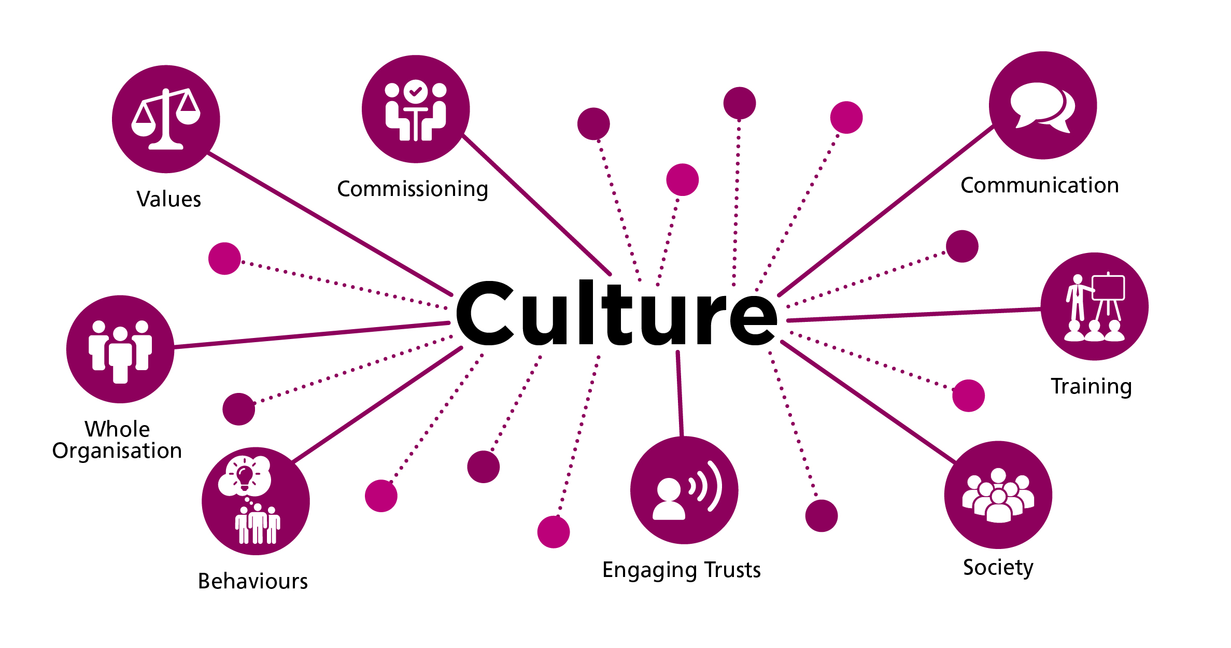
NHS organisational cultures
In the NHS we are looking for organisational cultures that put patients first, promote trust, respect and equality and are sufficiently open and transparent such that staff feel able to challenge each other robustly, regardless of status, without fear and are encouraged to come forward when difficulties arise.

Slide 12

Structure of the NHS
The NHS provides healthcare services to more than one million patients every 36 hours, and the vast majority of these services are free at the point of use for UK residents.
Many people think that the NHS is a single organisation with a central recruiting team, however this is not the case. The NHS is actually made up of multiple organisations, with each individual organisation having its own recruitment team and list of vacancies.
The structure of these NHS organisations varies slightly between the four UK nations, which is explained in more detail on the Health Careers website. In England, the organisations making up the NHS include:

Slide 13
The structure of these NHS organisations varies slightly between the four UK nations, which is explained in more detail on the Health Careers website. In England, the organisations making up the NHS include:
National bodies that oversee and regulate NHS services
Clinical Commissioning Groups (CCGs) that plan and commission care for local populations
Healthcare provider organisations
Primary care organisations – independent businesses offering NHS services, including GP practices, dental practices, opticians
Acute (hospital) trusts – providers of hospital-based NHS services
Mental health trusts – organisations which offer mental health and social care services
Community trusts – providers of community-based services, such as district nursing, physiotherapy and speech and language therapy
Ambulance trusts – organisations which offer NHS transportation services emergency and non-emergency care
Charities and social enterprises – organisations which provide support services to the NHS.
Structure of the NHS

Slide 14

Organisation’s Culture
Many elements can be included on the definition: organisation’s expectations, experiences, philosophy, as well as the values that guide member behaviour and is expressed in member self-image, inner workings, interactions with the outside world, and future expectations.
Culture is based on shared attitudes, beliefs, customs, and written and unwritten rules that have been developed over time and are considered valid but the organisation’s members.
Culture also includes the organisation’s vision, values, norms, systems, symbols, language, assumptions, beliefs, and habits (Needle, 2004).

Slide 15

Organisational Culture theories
When we check the concept of Organisational Culture, there are various points of view we need to take into consideration.
Maull, Brown and Cliffe have proposed (2001) a framework of reference to analyse Organisational Culture theories that I find useful, and that I will follow with a few updates.

Slide 16

Substantial literature that looks at national cultural elements, trying to identify their impact on organisations. Many tools have been developed in this respect, and some of the models we will see below
Models of organisation cultural

Slide 17

Culture As An Independent Variable
This view essentially looks at Organisational Culture as something that is “imported” into the organisation through membership. This view takes as its key premise there are specific characteristics of “good” cultures that are universal and easily imported into the organisation (Maull, Brown and Cliffe, 2001).
In this view, Culture is seen as something an organisation has
As such Culture can be crafted into something “positive” for the organisation, through specific change initiatives.
Several management theories look at the role of managers in creating effective corporate cultures that support corporate strategy.

Slide 18
Culture As A Dependent Variable
This view essentially states that organisations themselves are Culture producing phenomena. From this point of view organisations are seen as social instruments that produce goods and services, and, as by-product, they also produce distinctive cultural artifacts such as rituals, legends and ceremonies (Smircich, 1983).
As such each organisation develops a unique culture which is the product of its history, its development and the present situation.
Adopting this perspective means building the culture concept within a systems theory framework which holds that the organisations exist largely in a determined relationship with its environment (Maull, Brown and Cliffe, 2001).
It becomes the glue that holds things together, a strong culture being the element that creates the appropriate balance and effectiveness to the organisation (Deal and Kennedy, 1982).

Slide 19

.
Culture as a Belief System
“The pattern of shared beliefs and values that give members of an institution meaning and provide them with the rules for behavior in their organisation.”
(Davis, 1984) Thinking in terms of beliefs system means distinguishing between different types of beliefs. Some are profound, guiding thoughts that impact the actions of the entire organisation.
Difficult to change, they can be inferred from artefacts and behaviours of members. But there is also a second category of beliefs, sometimes called “daily beliefs”.
These can be described as the rules and feelings about everyday behaviour.
However, these are dynamic and situational, they change to match context. Under this set of definitions, organisational Culture is a set of shared assumptions that guide what happens in organisations by defining appropriate behaviour for various situations (Ravasi and Schultz, 2006)

Slide 20
Culture as a Belief System
“The pattern of shared beliefs and values that give members of an institution meaning and provide them with the rules for behaviour in their organisation.”
(Davis, 1984) Thinking in terms of beliefs system means distinguishing between different types of beliefs.
Some are profound, guiding thoughts that impact the actions of the entire organisation.
Difficult to change, they can be inferred from artefacts and behaviours of members.
But there is also a second category of beliefs, sometimes called “daily beliefs”. These can be described as the rules and feelings about everyday behaviour.
However, these are dynamic and situational, they change to match context.
Under this set of definitions, organisational Culture is a set of shared assumptions that guide what happens in organisations by defining appropriate behaviour for various situations (Ravasi and Schultz, 2006)

Slide 21

Culture as Strategy
Bate, 1995
I am not suggesting that Culture is like strategy (and vice versa), nor am I saying that Culture and strategy are closely related… What I am saying is that one is the other… Culture is a strategic phenomenon: strategy is a culture phenomenon.” (Bate, 1995).
The implication of this theme is a strong focus on strategy development as a cultural activity. The basic assumption is that beliefs impact the definition of strategy.

Slide 22

Culture as Mental Programming
One of the key promoters of this view is Hofstede (1980) who defined Culture as the “collective programming of the mind, which distinguishes the members of one category of people from another.
This definition stresses that Culture:
Is collective and not a characteristic of individuals (shared values)
Is mental “software”, therefore invisible and intangible as such
Is attractive only to the extent that it differentiates between categories of people.

Slide 23

Denison Organisational Culture Model
The model assesses strengths in four key areas of your corporate culture: Adaptability, Mission, Involvement, and Consistency.
Mission-Do you know where you’re going? Do you have clear goals and a strategy to reach them?
Adaptability. -Are you listening to the service users/patient to? How well do you identify and respond to their changing needs?
Involvement-How well do you empower employees, build teams, and develop the human capability in your organisation?
Consistency -Have you established coordinated systems that enable you to build agreement based on your core values?

Slide 24
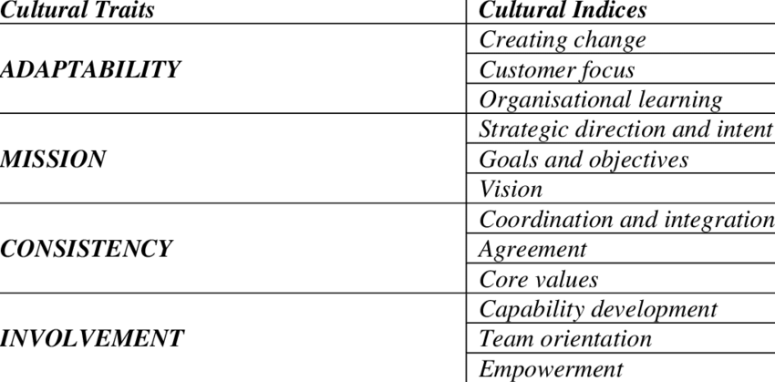
Denison Organisational Culture Model

Slide 25

Video on The Denison Organizational Culture Model
Video on The Denison Organizational Culture Model focuses on those aspects of organizational culture which have a proven link to business performance such as Sales Growth, Return on Equity (ROE), Return on Investment (ROI), Customer Satisfaction, Innovation, Employee Satisfaction, Quality and more.
https://youtu.be/4cBN8xH-5Qw

Slide 26
Handy Model of Organisational Culture
He also developed a model based on four specific types of cultures, each based on four characteristics Classes of Culture.
The idea is that civilisations can be organised as focused on Power, Roles, Task or Person.
Zeus presides over a highly centralised ‘Club’ Culture, where one dominant executive holds all the reigns of power, making all of the important decisions themselves.
Apollo – The Roles Culture Mature, bureaucratic organisations adopt a reliable, stable, rule-based culture, where everyone has a specific role.
Athena – The Task Culture-The Athena culture is a meritocracy, where the ability to think and get things done is highly valued and rewarded well. Talent is well rewarded, and teams are fluid, with people coming together to work on projects and solve problems.
Dionysus – The Existential Culture (People) -The Dionysus culture is all about me, me, me. It serves the individuals and can lead to both creative freedom and equally internal discord and unproductive competition.

Slide 27
.
Hofstede Model of Organisational Culture
A model that identified several components in the so-called six-dimension model (Hofstede, 1985).
Power Distance (PDI) – which indicates to the extent to which less powerful members of a society accept that power is distributed unequally.
Individualism versus Collectivism (IDV) – which means the level at which individuals look after themselves or their immediate families, or instead consider themselves a part of “larger groups”.
Masculinity versus Femininity (MAS) – is not about gender, but rather about dominant values expressed: achievement, performance, status in masculine societies, cooperation, people-orientation and consensus for the feminine societies.
Uncertainty Avoidance (UAI) – refers to the extent to which people feel threatened by uncertainty and unpredictability and try to avoid these situations.
Long-Term versus Short-Term Orientation (LTO) – refers to the extent to which a society exhibits a future-oriented perspective rather than a near-term point of view.
Indulgence versus Restraint (IVR) – refers to the level of relatively free gratification that some societies allow vs other where strict social norms regulate gratification.

Slide 28
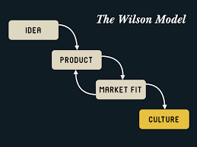
NOBL has developed a “Culture/Market Fit Model” that is loosely inspired by the Competing Values Framework.
The idea is based on the concept that you can identify a potential market.
But Then develop a culture that can deliver product/market fit. (NOBL Academy, 2019).
The Elephant Herd: these cultures value interpersonal dynamics and relationships above all else.
They are described by employees as being personal, mentoring, accepting, consensus-seeking, and trusting.
NOBL Culture/Market Fit Model

Slide 29

The Bird Flock: these cultures value agility above all else.
Employees use words like entrepreneurial, inventive, adventurous, inspiring, and fast-paced to describe these workplaces.
Bird flocks tend to excel at cultural intelligence, customer intelligence, and of course, speed to market. Think Beats, Zara, and Netflix.
These cultures tend to excel at strategies such as experience/service design, talent acquisition, and virtuousness. Think Patagonia, Pixar, and Zappos.

Slide 30

The Beehive: these cultures value process and procedure above all else. Employees say these cultures feel logical, stable, efficient, comfortable, and respectful.
Beehives often rock at achieving economies of scale, preserving intellectual property, and dominating on price. Think Toyota, GE, and Coca-Cola.
The Wolf Pack: these cultures value execution and results above all else. Their employees use words like competitive, goal-oriented, accountable, focused, and productive to describe their workplaces.
Wolf Packs can crush product design, geographical strategies, and capturing network effects. Think Facebook, Nike, and Bridgewater Associates. (NOBL Academy, 2019)

Slide 31
Deal and Kennedy model of organizational culture.
According to Deal and Kennedy’s (1982), the most significant single influence on a company’s Culture is the business environment in which it operated. They called this ‘corporate culture’, which they asserted embodied what was required to succeed in that environment.
This could be analyses by looking at two dimensions:
the degree of risk associated with the company’s activities, and the speed at which companies – and their employees – get feedback on whether decisions or strategies are successful.

Slide 32

Critical Review and Reflection
Personalities are an important part of the work organisation.
Whatever its formal structure, in practice the actual operations of the organisation and success in meeting its objectives will depend upon the behaviour and actions of people within the structure.
To what extent do YOU think people give shape and personality to the formal structure of YOUR selected Health and Social Care organisation?

